Slide 1
DSA 8 week Summer Training by CODING SPOON
Course Code : CSE 343
Submitted by
Name-M Krishna Manikanta
Registration No :12014766

Slide 2
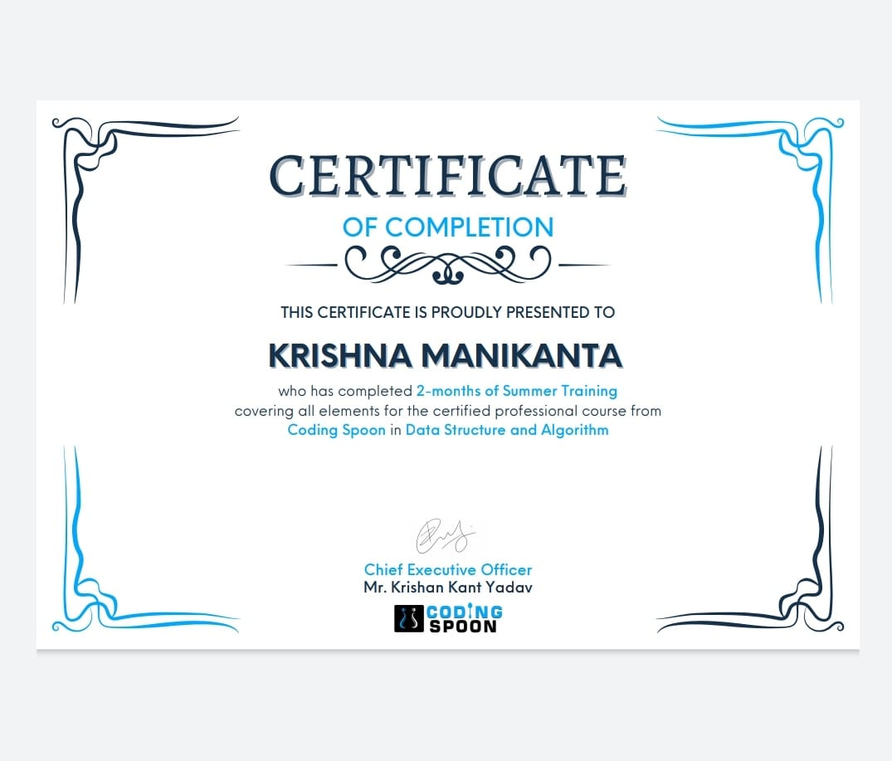

Slide 3
Why this course :
This course is a complete package that helped me learn Data Structures and Algorithms from basic to an advanced level. The course curriculum has been divided into 8 weeks where one can practice questions & attempt the assessment tests according to his own pace.
The course offers me a wealth of programming challenges that will help me to prepare for interviews with top-notch companies like Microsoft, Amazon, Adobe etc.
Data structures and algorithms (DSA) goes through solutions to standard problems in detail and gives you an insight into how efficient it is to use each one of them. It also teaches you the science of evaluating the efficiency of an algorithm. This enables you to choose the best of various choices.

Slide 4
Why DSA is important :
Data structures and algorithms are an essential part of computer science because they help us to store, process, and analyze large amounts of data.
Without these tools, it would be practically impossible to collect, process, and analyze all the data that is generated by computers around the world. In data structures, we learn how to organize data using various techniques, such as arrays and linked lists. In algorithms, we study the various ways that computers can be programmed to solve problems.

Slide 5
Technology Learnt :
Learn Data Structures and Algorithms from basic to an advanced level
Learn Topic-wise implementation of different Data Structures & Algorithms as follows
Analysis of common loops
Analysis of Recursion
Space Complexity
Arrays and Strings
Searching and Sorting
Hashing
Linked List
Stacks, Queues and Deque
Tree
Binary Search Tree
Heap
Graphs
Tree
Segment Tree

Slide 6
Project description :
Travel management system is a project where user can book his/her tickets just by entering their choices between the cities by creating an account and then logging into the account.
Then the travel charges will be appear on the screen and then if the user was interested to book his/her tickets then the user must enter the no.of passengers and their details to book the tickets

Slide 7
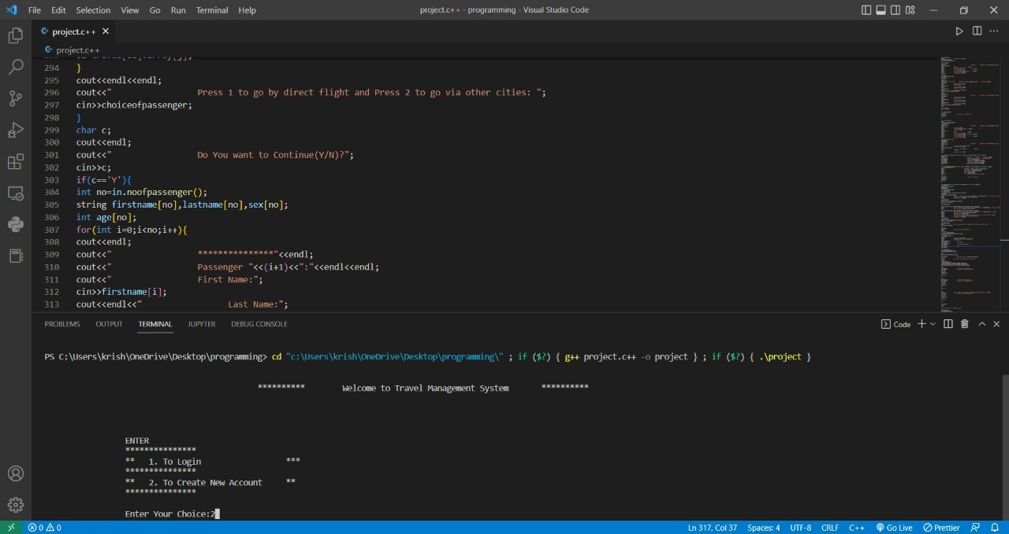
The main page:

Slide 8
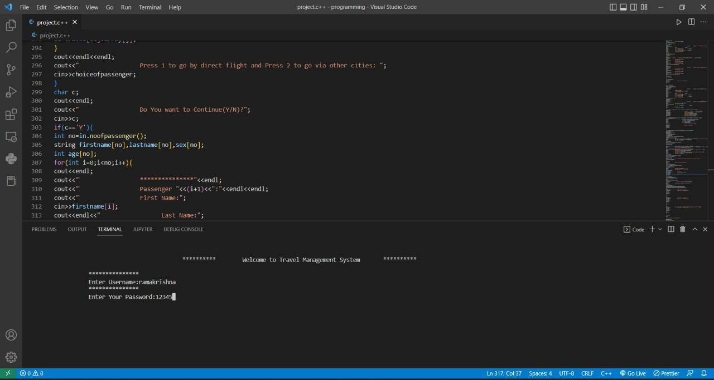
User creating new account

Slide 9
User creating new account

Slide 10
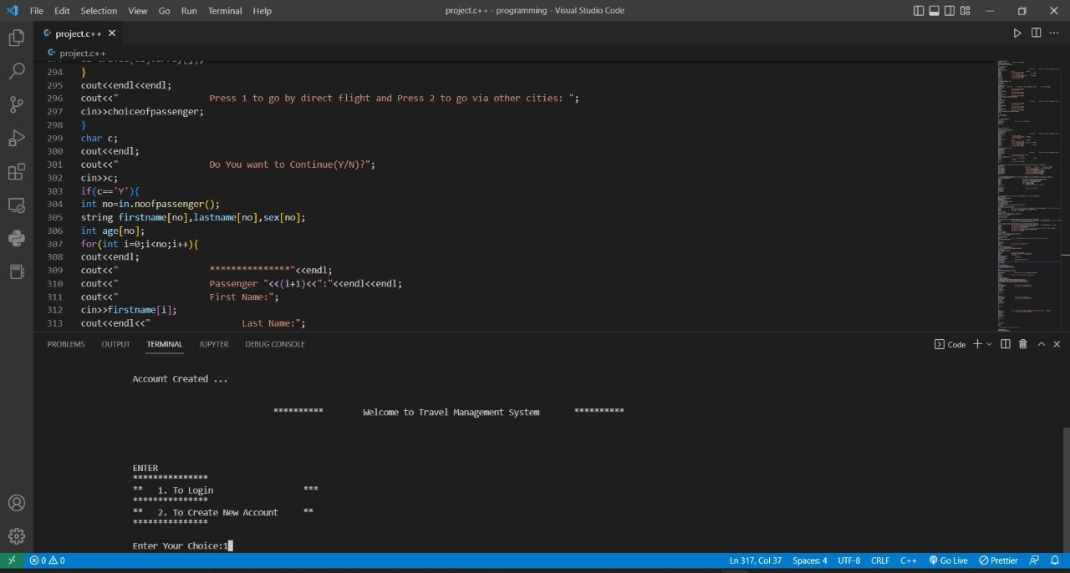
User login

Slide 11
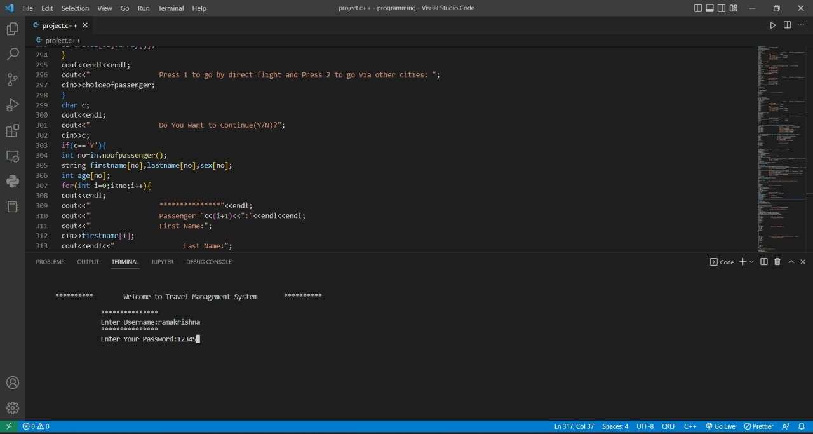
User login

Slide 12
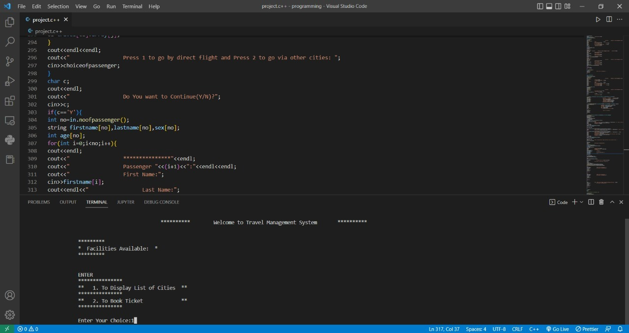
Facilities available for the user:

Slide 13
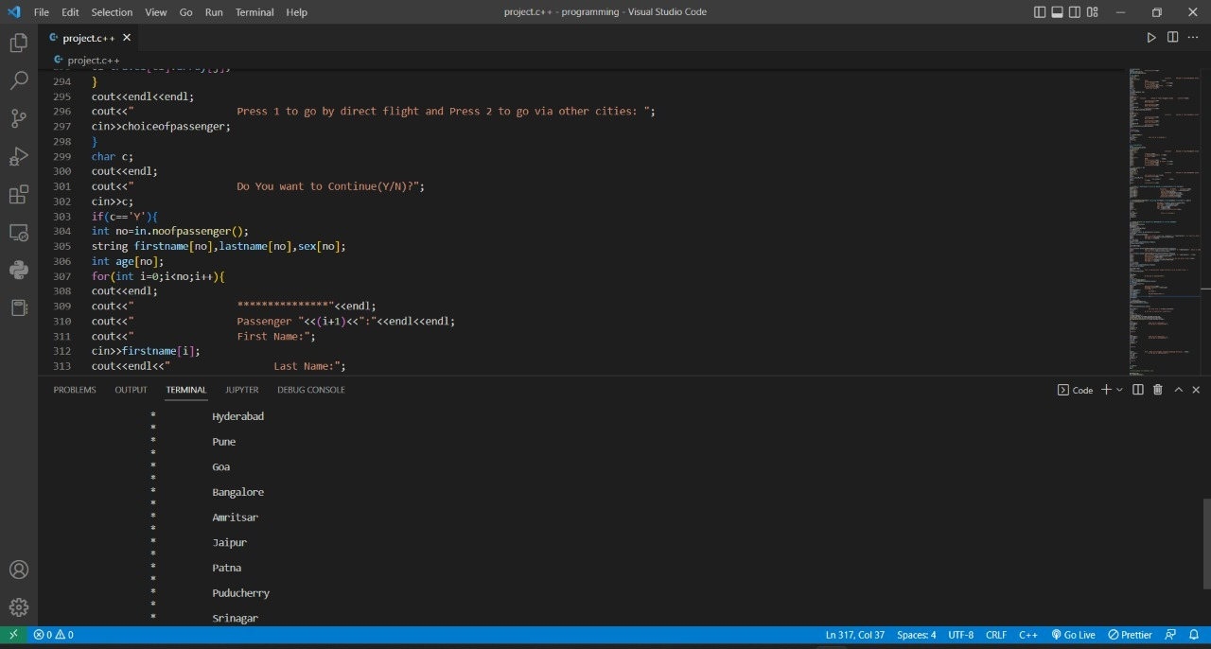
List of Cities

Slide 14

Facilities available:

Slide 15
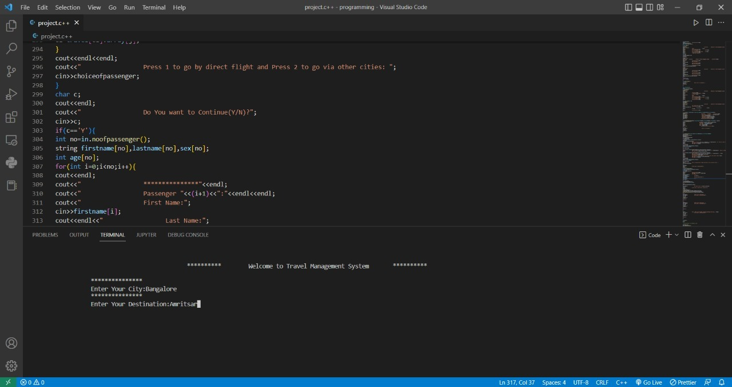
User booking ticket:

Slide 16
User booking Ticket:

Slide 17
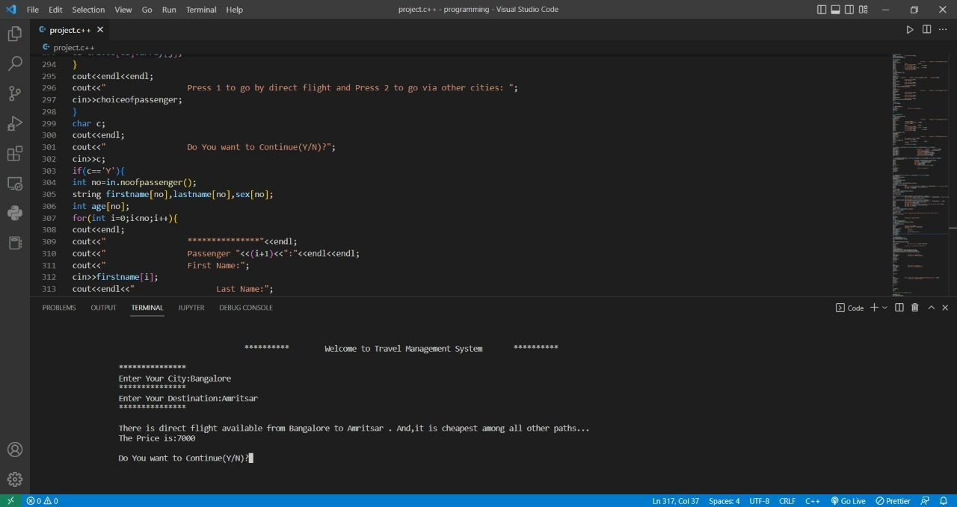
System showing the price between the cities and asking the user to continue …

Slide 18
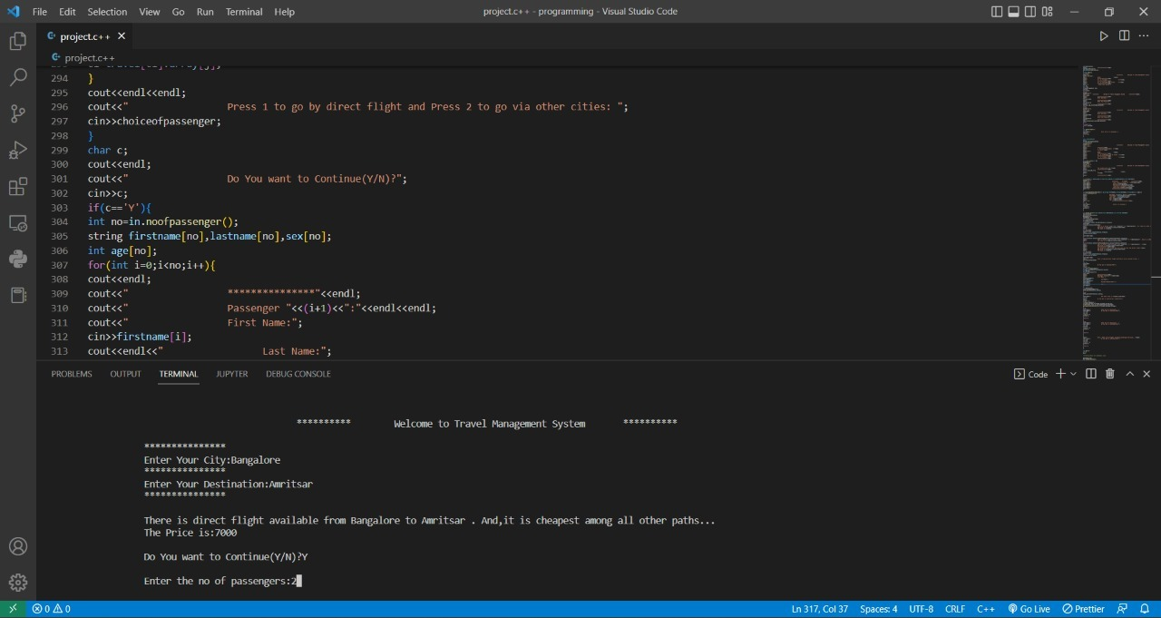
If user choice is YES

Slide 19
It asks for the no.of passengers…

Slide 20
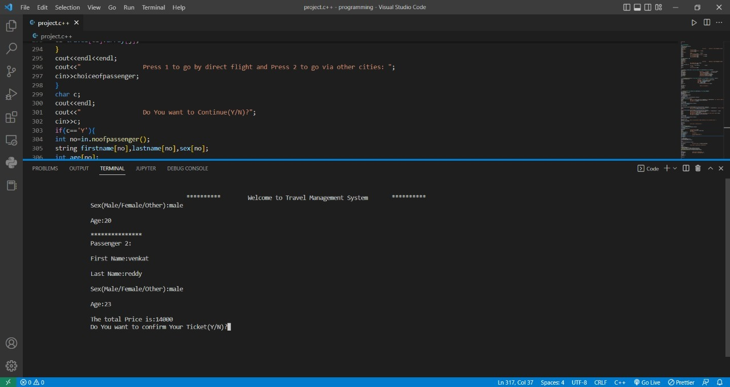
And then asks the user to enter their details….

Slide 21
When the user enter the details and conforms it then system will be returning back to the home screen….

Slide 22


